Slide 1
Universal Credit – how to support claimants on their UC journey
April 2019
Notes:
Notes from Watford training session:
We need a list /tool kit to look help remind advisers of what to ask about re: what kind of payments clients may receive after leaving work / or appealing a benefit
If we have to support a client from beginning to end – that’s a 2 hour session. How do we fit that in to generalist service. What do we need to do first? - better off calc and benefit check. Go through is this the right benefit for a client – explain conditionally etc. May be that can be interview one – then ask client to come back so we can check they have filled form out correctly?
How many client need a full end to end service?

Slide 2
What is Universal Credit?
6 means tested benefits
Income-based Jobseeker's Allowance (JSA)
Income-based Employment Support Allowance (ESA)
Housing benefit (HB)
Income Support (IS)
Child Tax Credits (CTC)
Working Tax Credits (WTC)
Universal Credit
Notes:
UC is a new benefit for those on a low income or out of work
A quick reminder!

Slide 3
Help To Claim Service
Notes:
These are the steps in our new Help To Claim service in Watford. There is a national help line running form 8 till 6 – separate to Adviceline but we will have resources to put a paid adviser on 2 days a week. This is phone and webchat – so this will be the first time we have access to web chat and a great opportunity to learn
We don’t know yet how people will access our service through the telephone line / our own telephone lone or via Job Centre referrals. A lot of this service will be evaluating and testing as we go along.
The network pilots and national are trialling the assessment tool. For now we can use ours. Important to say that if we receive a referral form the Help Line the triage will have been done – no need for us to do it again.
But we are here today to talk about Steps 3 and 4.

Slide 4
Delivering phone and chat
Phone and chat will be delivered through a single national queue, with paid staff and a freephone number that’s separate to Adviceline.
If a client is accessing the service via the freephone number and we can identify their local Citizens Advice, their call will be directed to this office first if an adviser is available. If no local adviser is available, the call will be directed to the next available adviser.
The national freephone numbers for Universal Support: Help to Claim are:
England - 0800 144 8 444
Wales - 08000 241 220
Notes:
https://www.citizensadvice.org.uk/cablink/advice-and-education/Access-routes-to-advice/service-management-and-improvement/support-for-our-services/guides-for-delivering-services/email-and-web-chat-user-guides1/

Slide 5
Step 3: Support to start a claim
@
Check entitlement
Set up email or accounts
Work through to-dos
Access phone or home visit support
Notes:
Step Three has 4 stages that need to be completed

Slide 6
Check Entitlement
Speculative claims Pitfall #1
If you are on a legacy benefit you may be better off
Changes with SDP in January
Not just a better off calculation – 6 levels of in work conditionality
Work out when the best time to apply
Check if you're eligible for Universal Credit
Notes:
As explained earlier, the way UC is advertised is many think it’s a new benefit for work without realising that they could have a choice between a legacy benefit and UC. Or thinks its an additional benefit.
Pitfall no 1 Speculative claims
Legacy benefits - If you are already on a legacy benefit – check if they are better off.
Till May 2019 if your client lives with a partner who’s over Pension Credit age, check if the couple can get Pension Credit before looking at Universal Credit eligibility. When making a joint claim they’ll usually get more money by claiming Pension Credit instead.
If you are appealing a decision on DLA/ESA it may be worth waiting till the appeal has been heard.
If you are waiting for a final payment from you employer – may be worth waiting for that payment to come through otherwise it will be included in your assessment period.
Don’t apply for Universal Credit if you have a visa that says “no recourse to public funds” or you’re subject to immigration control. It could affect your right to stay in the UK.

Slide 7
Preparation
Does client have a bank account /email find out how to set up an email address (link)
prepare for UC - (Link)
Apply for Universal Credit (guidance on Advsiernet)
Gather everything you’ll need to apply - attached list
Notes:
How many accounts could we be talking about – 4 potentially.
An email account
A bank account
An Online account
A UC claim.
Part 1 of the client journey can be very time sensitive for a client. Their entitlement to UC doesn’t normally start until they press the submit button, a phone claim has started, or a home visit booked. Therefore, we need to ensure clients get this support as soon as possible.
Remember – ask the client if they have a bank account – they cant progress the claim till they have their bank account details. This takes time to set up. Where is the best place to get a basic free bank account?
How many of feel confident they could help a client set up an email account?)
Prepare for UC is a You tube link to to prepare to make a claim.
Apply for UC – is a link to Adviser net
Gather everything you need is a hand out and link to adviser net
Its best to get the client prepared so they have all the information they need to progress the claim. Hand out 2

Slide 8
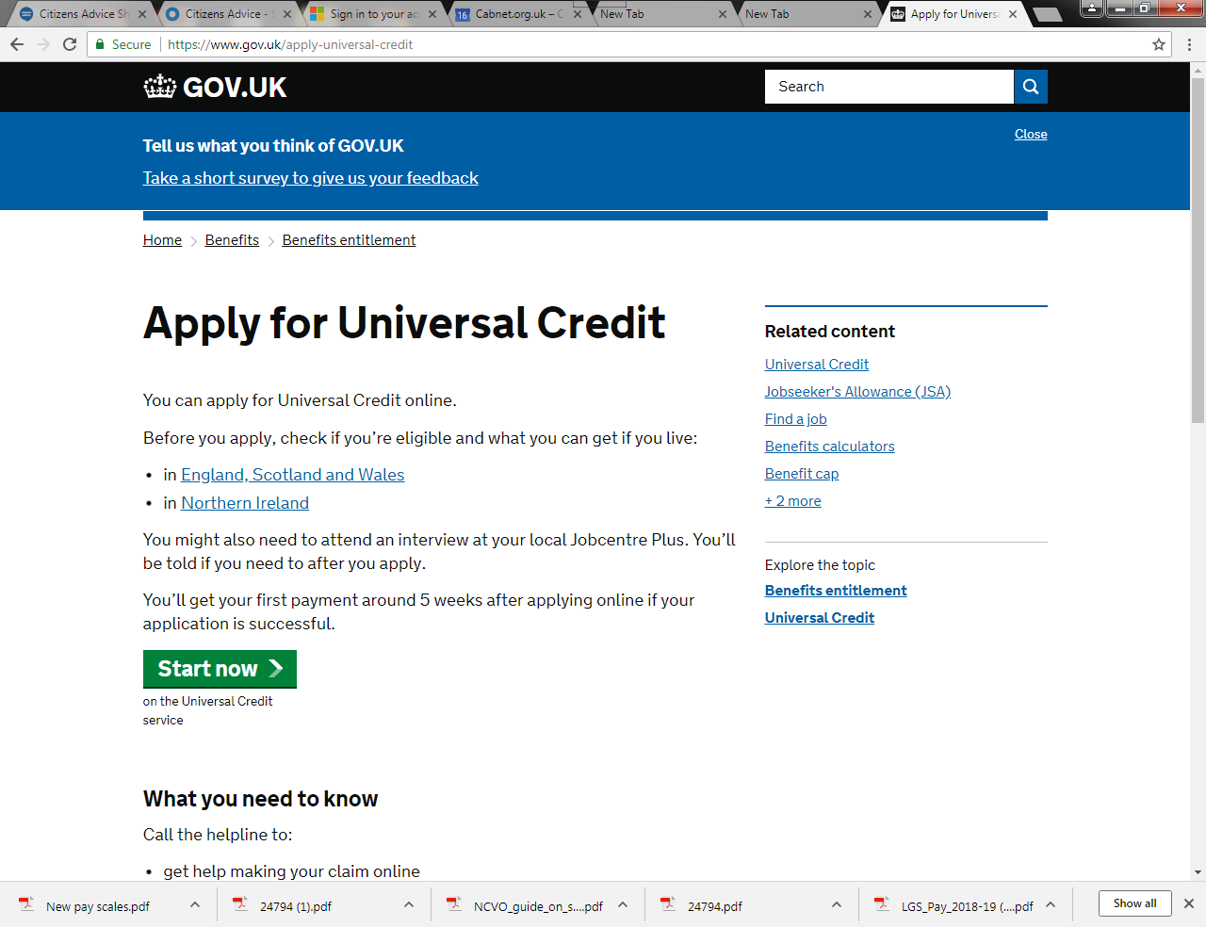
Set up online account
you’ll need to apply for Universal Credit online a lingk to GOV.UK
making a joint claim
16 digit number
Opening an account
Notes:
Big issue here is the user name & password and 16 digit number. They also have to set up a username and password to the account and write down a link code to test the email address works.
16 digit number - Depending on the IT equipment you use – take a screen shot / print it off. But be careful of retaining that information – its data sensitive and covered by data protection rules.
There are rules about joint claims. If you are in a couple – you both have to make the claim and when you go through the online application .. You will be given a link code. Don’t forget to write that down either.
Up till now we have said we cant help people make a claim just give advice. We can now:
Do’s – help client set up an email. Give them the handout on what to do if they can help themselves
Dos - help them set up an online account.
Don’t - Big issue here is the user name & password and 16 digit number. Don’t forget to write it down, don’t write it in your casenotes or keep it for the client. Depending on the IT equipment you use – take a screen shot / print it off. But be careful of retaining that information – its data sensitive and covered by data protection rules.
NOTE : we could make a crib sheet here for the client to take away
There are rules about joint claims. If you are in a couple – you both have to make the claim and when you go through the online application .. You will be given a link code. Don’t forget to write that down either.

Slide 9
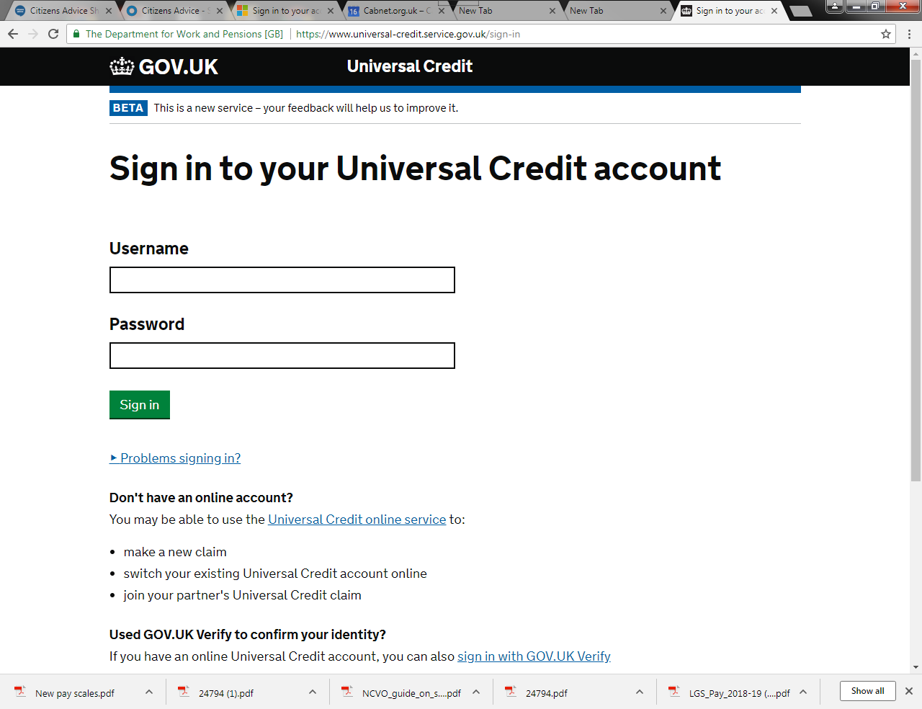
Start the UC claim
This is separate from setting up your account
Making a Claim - a link
Notes:
This is separate from setting up your account. It’s worth starting your claim as soon as you can, as it will mean you get your Universal Credit payment sooner
Once you’ve logged in, you’ll see a ‘to do’ list. You’ll need to go through the list answering questions about your situation. If you’re making a joint claim you’ll see your partner’s to do list as well. They’ll have to log into their account to answer some of the questions.
One of the items on your to-do list says ‘Verify your identity online’. This takes you to a government system called ‘Verify’ to confirm your identity.
Verify can be difficult to complete. If you’re having problems, go back to your Universal Credit account and click on ‘I can’t do this online’. You can then skip this step and confirm your identity at the Jobcentre instead
The link talks about the tod page and a linked claim.
For those who have only claimed Tax credits – this is new and you need to involve the other partner – they will also have to verify their identity and attend the interview at the Job centre

Slide 10
Work through the to dos
Notes:
This a review of the web site page – completing the to dos and checking the information is right is part of the Help to Claim service
You can check the adviser net pages for more information

Slide 11
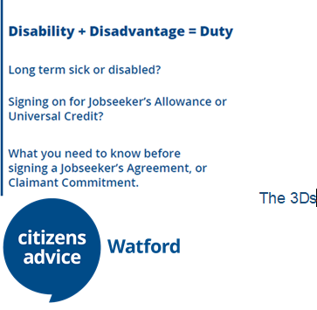
Access phone or home visit support
Notes:
If a client absolutely cant make a claim on line due to disability then they can make a phone claim or arrange a home visit. The date of claim is from the time of the phone call or home visit.
Use the 3 ds to help the client think about their disability and to explain to JCP why they cant make an online claim

Slide 12
Arrange an interview at the job centre
Notes:
Once you submit your claim you’ll need to arrange an interview at your local Jobcentre within 7 days of applying online. If you don’t arrange the interview in time you might have to start your application for Universal Credit again.
You should be given a phone number to call to arrange your interview after you apply online. You’ll need your National Insurance number when you make the call.
If you aren't given a phone number, call the Universal Credit helpline to arrange your interview.
Universal Credit helpline Telephone: 0800 328 5644 Open Monday to Friday 8am to 6pm
Calls to this number are free.
The person you speak to when you arrange your interview will tell you where your interview is and what documents to take with you.
After you’ve arranged the interview you’ll be able to find details about it in your online Universal Credit account.
You should still call if an interview will be difficult for you because you’re ill or disabled. You can ask the Jobcentre to change things to make it easier for you - this is called a ‘reasonable adjustment’. For example, you can ask for a British Sign Language interpreter, or for your interview to be at a place you can get to easily
Check with the client how they can get to the Job Centre
Use the 3 Ds form to prepare them. JCP has the duty to ensure they take in to account a persons disability. This means they have to make reasonable adjustment – in travelling to the office (remember the on hour rule) and in agreeing what is reasonable for a job search.

Slide 13
Pitfall 2
Don’t forget to arrange an appointment
Of the 1 in 5 application failures over half were due to appointments not being made.
Notes:
So, they have

Slide 14
Step 4: Completing a claim
Depending on their level of need this might include help to:
Verify their identity
Access adaptations and easements
Provide additional evidence
Apply for additional financial support
Understand monthly payments
Notes:
You’ve submitted the online form but all these things need to be done to complete the claim – no payment is made till then

Slide 15
Verify identity
Pitfall #3
Verify you identity
Notes:
This is where most people fall down.
As you will from the video –
Remember if they cant do it online – they need to go to the job centre

Slide 16
Additional Evidence
Check the evidence is right Pitfall # 4
Apply for Universal Credit link to adviser net
Notes:
This is where most people fall down.
As you will from the video –
Remember if they cant do it online – they need to go to the job centre

Slide 17
Access, adaptations and easements
The work claim commitment
In work conditionality
Notes:
Use the 3 ds to help the client understand how their disability affects their ability to look for work – or even attend the interview

Slide 18
Apply for additional financial support
To claim or not to claim
Other financial support available
Total deductions will go down to 30% of claim but ask if they have overpayments
Notes:
remember 100% advance payment is not always in the clients interests – it’s a lot to pay back – some of it is for rent so cant spend it all. – check how much they can live off.

Slide 19
Understanding Monthly payments
New style JSA
Timing of other income / direct debits
Housing costs for social landlords
Notes:
This is key to stop the client getting into arrears in rent etc. Hand out re social land lord rent – 53 week rent period but UC is paid 12 calendar months.

Slide 20
Pitfall #5
The online journal – working through the to-dos
working with your coach
the online journal
homepage of the journal
Notes:
all your communication is with DWP is here
You can scan / take photos etc.
This is absolutely your go to place to find out any information about the clients claim. Check here before ringing the DWP. If you have to ring the DWP – use the clients phone (if it’s a mobile) number they put on the claim form as it gets right through to the correct service centre – otherwise you hang on the phone for a long time. Also, you can ask questions through the journal – best to do this as its evidence and the answer comes quicker.

Slide 21
Help To Claim Service
Notes:
These are the steps in our new Help To Claim service in Watford. There is a national help line running form 8am till 6pm – separate to Adviceline but we will have resources to put a paid adviser on 3 days a week. This is phone and webchat.
The network pilots and national are trialling the assessment tool. For now we can use ours. Important to say that if we receive a referral form the Help Line the triage will have been done – no need for us to do it again.
How does it work in Watford?

Slide 22
Help To Claim in Watford
What we have to consider
If a client is eligible they may need to make a claim quickly.
We will see clients in our office
Appointments will be made via casebook
We have 2 paid workers to support clients in the office Mon-Fri
People who need one to one support to make a claim will be seen Mon, Tue
People who don’t need one to one can use public access computers on Friday.
Notes:
We have been given resources for the Help Line, Webchat and face to face. However, as step three – helping to make the claim - is time sensitive we will have to use our resources wisely.

Slide 23
Accessing the service
Jobcentres
Local Authorities
Self-referral
Support agencies
Notes:
This is where are clients will come from either via referral routes or drop in or the Telephone help line

Slide 24
Support materials
Our Universal Credit content on the public site, including:
What Universal Credit is
Check if you're eligible for Universal Credit
How Universal Credit is paid
Moving to Universal Credit from other benefits
Apply for Universal Credit
Reapply for Universal Credit
Preparing for your Universal Credit interview
Get an advance payment of Universal Credit
Getting Universal Credit if you're sick or disabled

Slide 25
DWP internal guidance on Advisernet, including:
Verify
Complex needs
Giving evidence
Proving identity
Eligibility for alternative payment arrangements
Home visits
DWP resources on the Universal Credit online system
We are also working with the DWP to agree that each Jobcentre will invite local Citizens Advice to come to their office and use their online claim training site.
In the meantime, advisers can watch videos on the Universal Credit online system to better understand how it works:
A range of public videos
Some additional videos for Citizens Advice use
Processes
Introduction to case recording [ 240 kb]
Universal support: Help to Claim Casebook recording guidance
Model write-up for client case records
What does good customer service look like on email and web chat?
How to contact Expert Advice team
Advanced subject knowledge
Universal Credit adviser resources on Advisernet
DWP internal guidance on Universal Credit
Benefits updates from the Expert Advice team
Case law summary

Slide 26
Questions or comments?

